Slide 1
Memory management

Slide 2
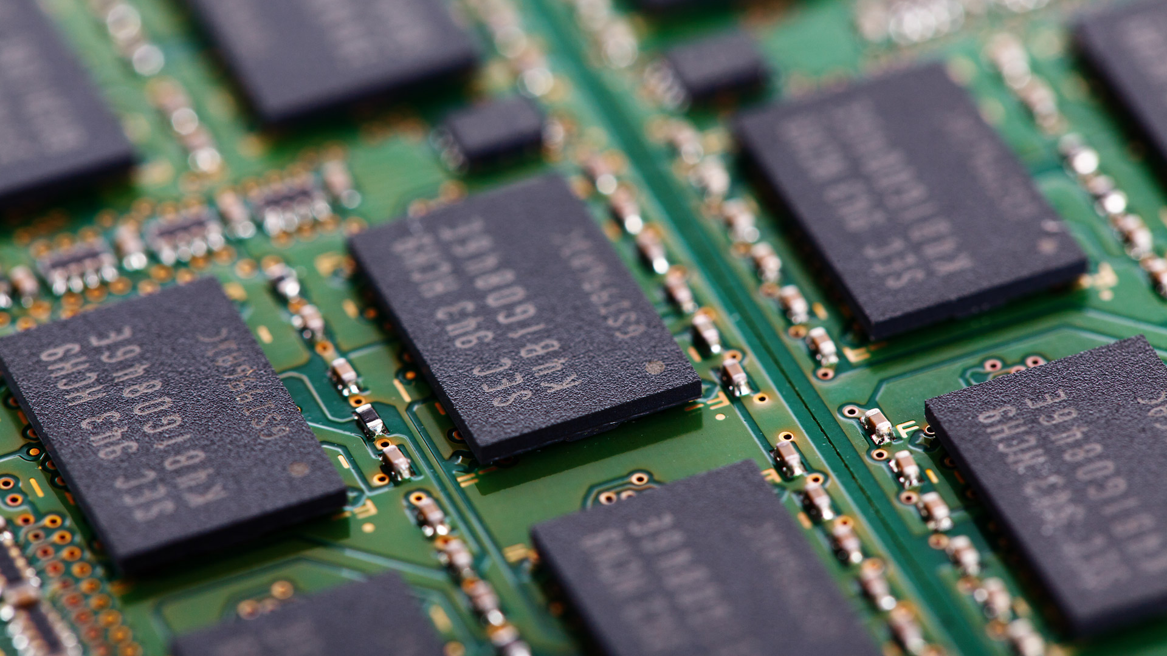
Code Segment
BSS
Data Segment
Notes:
The memory a program uses is typically divided into a few different areas, called segments:
The code segment (also called a text segment), where the compiled program sits in memory. The code segment is typically read-only. Fixed size
The bss (block started by symbol or “better save space”) segment (also called the uninitialized data segment), where zero-initialized global and static variables are stored. Fixed size
The data segment (also called the initialized data segment), where initialized global and static variables are stored. Fixed size
The heap, where dynamically allocated variables are allocated from. Grows up
The call stack, where function parameters, local variables, and other function-related information are stored. Grows down

Slide 3
Code Segment
BSS
Data Segment
Heap
Stack
Notes:
Right now, we care mainly about the heap and the stack.
The heap is a big pool of memory (the “free store”) and anything we dynamically allocate (using new in c++) is put there.
Meanwhile, whenever we declare a variable in a function, it is pushed onto the stack and as soon as that function exits, all the variables associated with that function are popped off the stack. Which is why tracking the scope of a variable is important, as soon as a local variable is popped off the stack it is lost forever and any reference to it will be invalidated.

Slide 4
struct OK
{
unsigned int UnsignedValue;
float FloatValue;
int SignedValue;
};
UnsignedValue
FloatValue
SignedValue
struct OK2
{
unsigned int UnsignedValue;
float FloatValue;
bool BooleanValue;
};
UnsignedValue
FloatValue
BooleanValue
Notes:
A brief interlude; as we may also want to consider how our objects are laid out in memory, we can visualize the memory layout in a nicely straightforward way – each box represents the underlying size of the variable: so ints are 32 bits (or 4 bytes) and Booleans are 8 bits (or ¼ the size of an int) and we can easily see that relationship. These first two show structs that are, without any fiddling, nicely aligned on memory boundaries.
As we start to think more carefully about the layout of our structs and classes in memory, we may start to wonder what happens when small data members are interspersed with larger members. While we may imagine that the compiler will organize this structure in memory “sensibly”, but we would be wrong (most of the time). The compiler leaves these “holes” because each data type has a natural alignment that has to be respected to let the CPU read and write memory effectively.
An object with 1-byte alignment resides at any memory address, 2-byte alignments reside at even addresses, 4-byte alignments reside at addresses that are multiples of 4 and 16-byte alignments at addresses that are multiples of 16. Ignoring these alignment requirements mean a CPU may have to read two 4-byte blocks (or worse) – some CPUs will in fact abort if you request data that is unaligned, causing a crash.

Slide 5
U1
struct MoreEfficient
{
unsigned int U1;
float F2;
int I4;
char *P6;
unsigned short U3;
bool B5;
};
U1
struct Inefficient
{
unsigned int U1;
float F2;
unsigned short U3;
int I4;
bool B5;
char *P6;
};
F2
F2
U3
I4
I4
P6
B5
U3
B5
P6
Notes:
Let’s consider a pretty normal looking struct – Inefficient; we can count up the size of each of the elements and it looks like a sizeof call should tell us it’s 19 bytes… But if we actually do that, we get a size of 24 bytes! It’s because the compiler is keeping our structure memory aligned, so the 2 byte short actually takes up 4 bytes, as does the 1 byte bool.
We can optimize this by just reordering the variables, as we can see with MoreEfficient – the size of this structure is now only 20 bytes, so we’ve managed to remove 4 bytes of padding – that may not seem like much, but imagine if this was a game where we had hundreds of units, each of which had a struct like this attached to them…
It’s worth noting that these optimisations will have different impacts depending on the compiler used, these numbers are from the VS compiler.

Slide 6
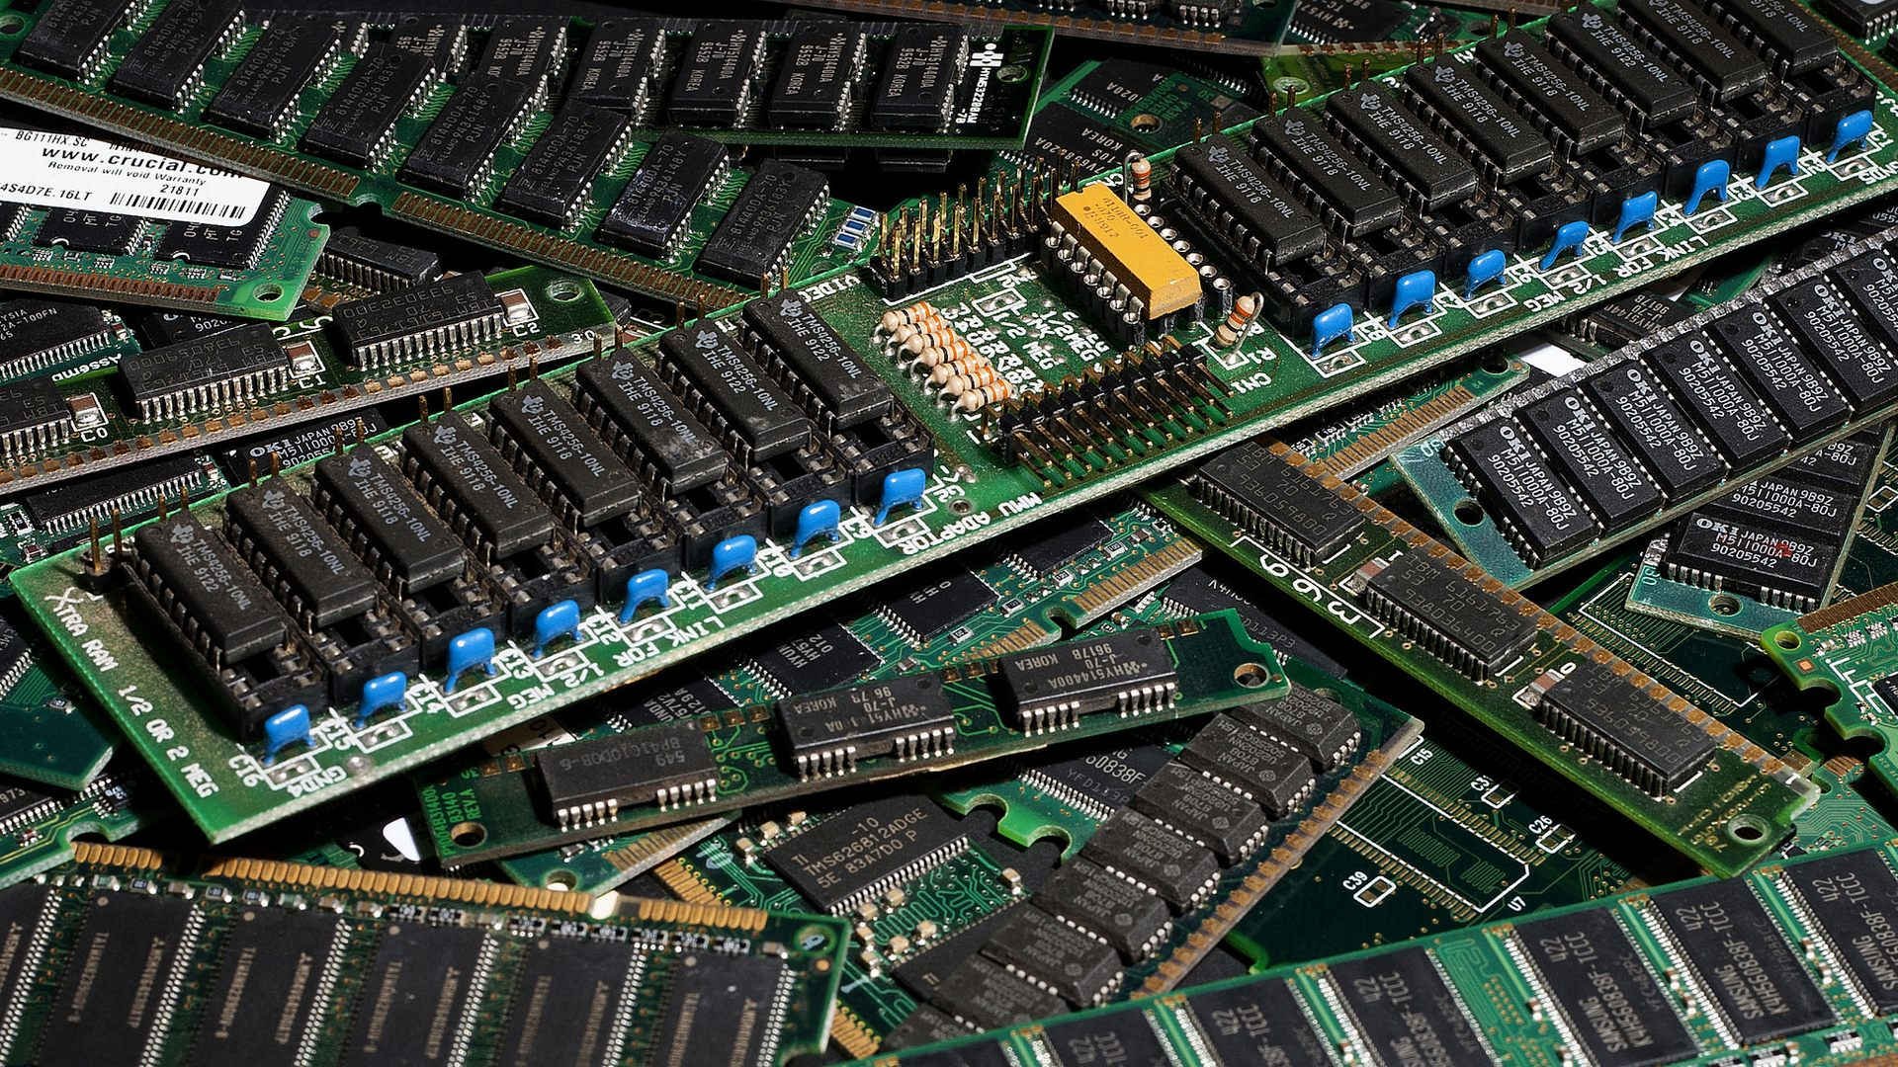
QueryPerformanceCounter(&StartingTime);
for (int i = 0; i < LOOP_LENGTH; i++)
{
MoreEfficient temp;
}
QueryPerformanceCounter(&EndingTime);
Loop Size | Stack Alloc | Heap Alloc
1000 | 8 | 55
10,000 | 50 | 553
100,000 | 605 | 4588
1,000,000 | 6538 | 51,211
QueryPerformanceCounter(&StartingTime);
for (int i = 0; i < LOOP_LENGTH; i++)
{
new MoreEfficient();
}
QueryPerformanceCounter(&EndingTime);
Notes:
Now back to the main attraction – memory management. So dynamic allocations are “bad”, you’ve heard me say it plenty and you could write some code that times things and see it for yourself if you really don’t believe these numbers (which are measured in microseconds here (using a release build, rather than debug)).
However, having said that, dynamic allocations are unavoidable, we can’t just keep everything on the stack – I’m hopeful that by now you can tell that would be a bad idea. So how can we improve on this? We can write our own memory managers and allocators, which allocate a load of empty memory (the expensive, slow bit) when they’re first created and make that memory available for use during run time.

Slide 7
We need stdlib for malloc
#include <stdlib.h>
class LinearAllocator
{
public:
LinearAllocator(int bufferSize) : bufferSize(bufferSize),
currentOffset(0)
{ buffer = (char*)malloc(bufferSize); }
~LinearAllocator();
void* Alloc(size_t size);
void Free(void *mem);
private:
char *buffer;
int bufferSize;
int currentOffset;
};
LinearAllocator::~LinearAllocator()
{
free(buffer);
buffer = nullptr;
}
void * LinearAllocator::Alloc(size_t size)
{
if (currentOffset + size > bufferSize)
return nullptr;
void *memToReturn = buffer + currentOffset;
currentOffset += size;
return memToReturn;
}
The constructor allocates the memory buffer
The destructor just frees our allocated memory.
Make sure we’ve got the space for the amount we want
We can’t actually free specific memory in a linear allocator.
The data type for the buffer is char as that guarantees bytes!
We move our offset by the size of the amount we’re requesting
Notes:
There are several approaches to custom allocators, we could overload malloc or new (malloc just allocates us a lump of memory to use, new does the same thing but then also calls an objects constructor) – but we then run into an issue where other developers on our team may be using those functions in different ways that we don’t account for, leading to unusual bugs that are particularly difficult to track down. A more straightforward approach, that provides us with easier use cases is to come up with a custom allocator (or a series of custom allocators, each designed to provide slightly different functionality). The most straightforward allocator is a linear allocator, which is not designed to allow for any specific memory to be released, we can just clear the entire lump.

Slide 8
#include <cstdint>
#include <cstdlib>
class StackAllocator
{
public:
typedef uint_least32_t U32;
typedef U32 Marker;
explicit StackAllocator(U32 stackSize);
~StackAllocator();
void* Alloc(U32 size);
Marker GetMarker();
void FreeToMarker(Marker marker);
void Clear();
private:
Marker currentMarker;
Marker startMarker;
};
Allocations start at the current stack marker
Still need malloc!
void * StackAllocator::Alloc(U32 size)
{
Marker temp = currentMarker;
currentMarker += size;
return (void*)temp;
}
StackAllocator::Marker StackAllocator::GetMarker()
{
return currentMarker;
}
void StackAllocator::FreeToMarker(Marker marker)
{
currentMarker = marker;
}
void StackAllocator::Clear()
{
currentMarker = startMarker;
}
The marker is then incremented by the requested size.
#include "StackAllocator.h"
StackAllocator::StackAllocator(U32 stackSize)
{
startMarker = (U32)malloc(stackSize);
currentMarker = startMarker;
}
StackAllocator::~StackAllocator()
{
free((void*)startMarker);
}
uint_least32_t ensures we get at least a 32 bit unsigned int
Allocate the required space and setup our marker positions
The explicit keyword stops the compiler allowing implicit conversions of the argument type
Free all allocated memory
We can move our current marker back down the stack, ‘freeing’ anything after it.
We never actually free the memory until deconstruction.
Notes:
For something that requires some more control, we can implement a stack allocator – this lets us roll back allocations to a prior point (any given marker, including the start of the stack allocation). From this sort of basic implementation, we can step forward into a double ended stack, with two stack allocators working on either end of a block of memory (one fills upwards, the other down), we just need to be careful to avoid overrunning from one side to the other. This greatly improves the efficiency of our memory usage.

Slide 9
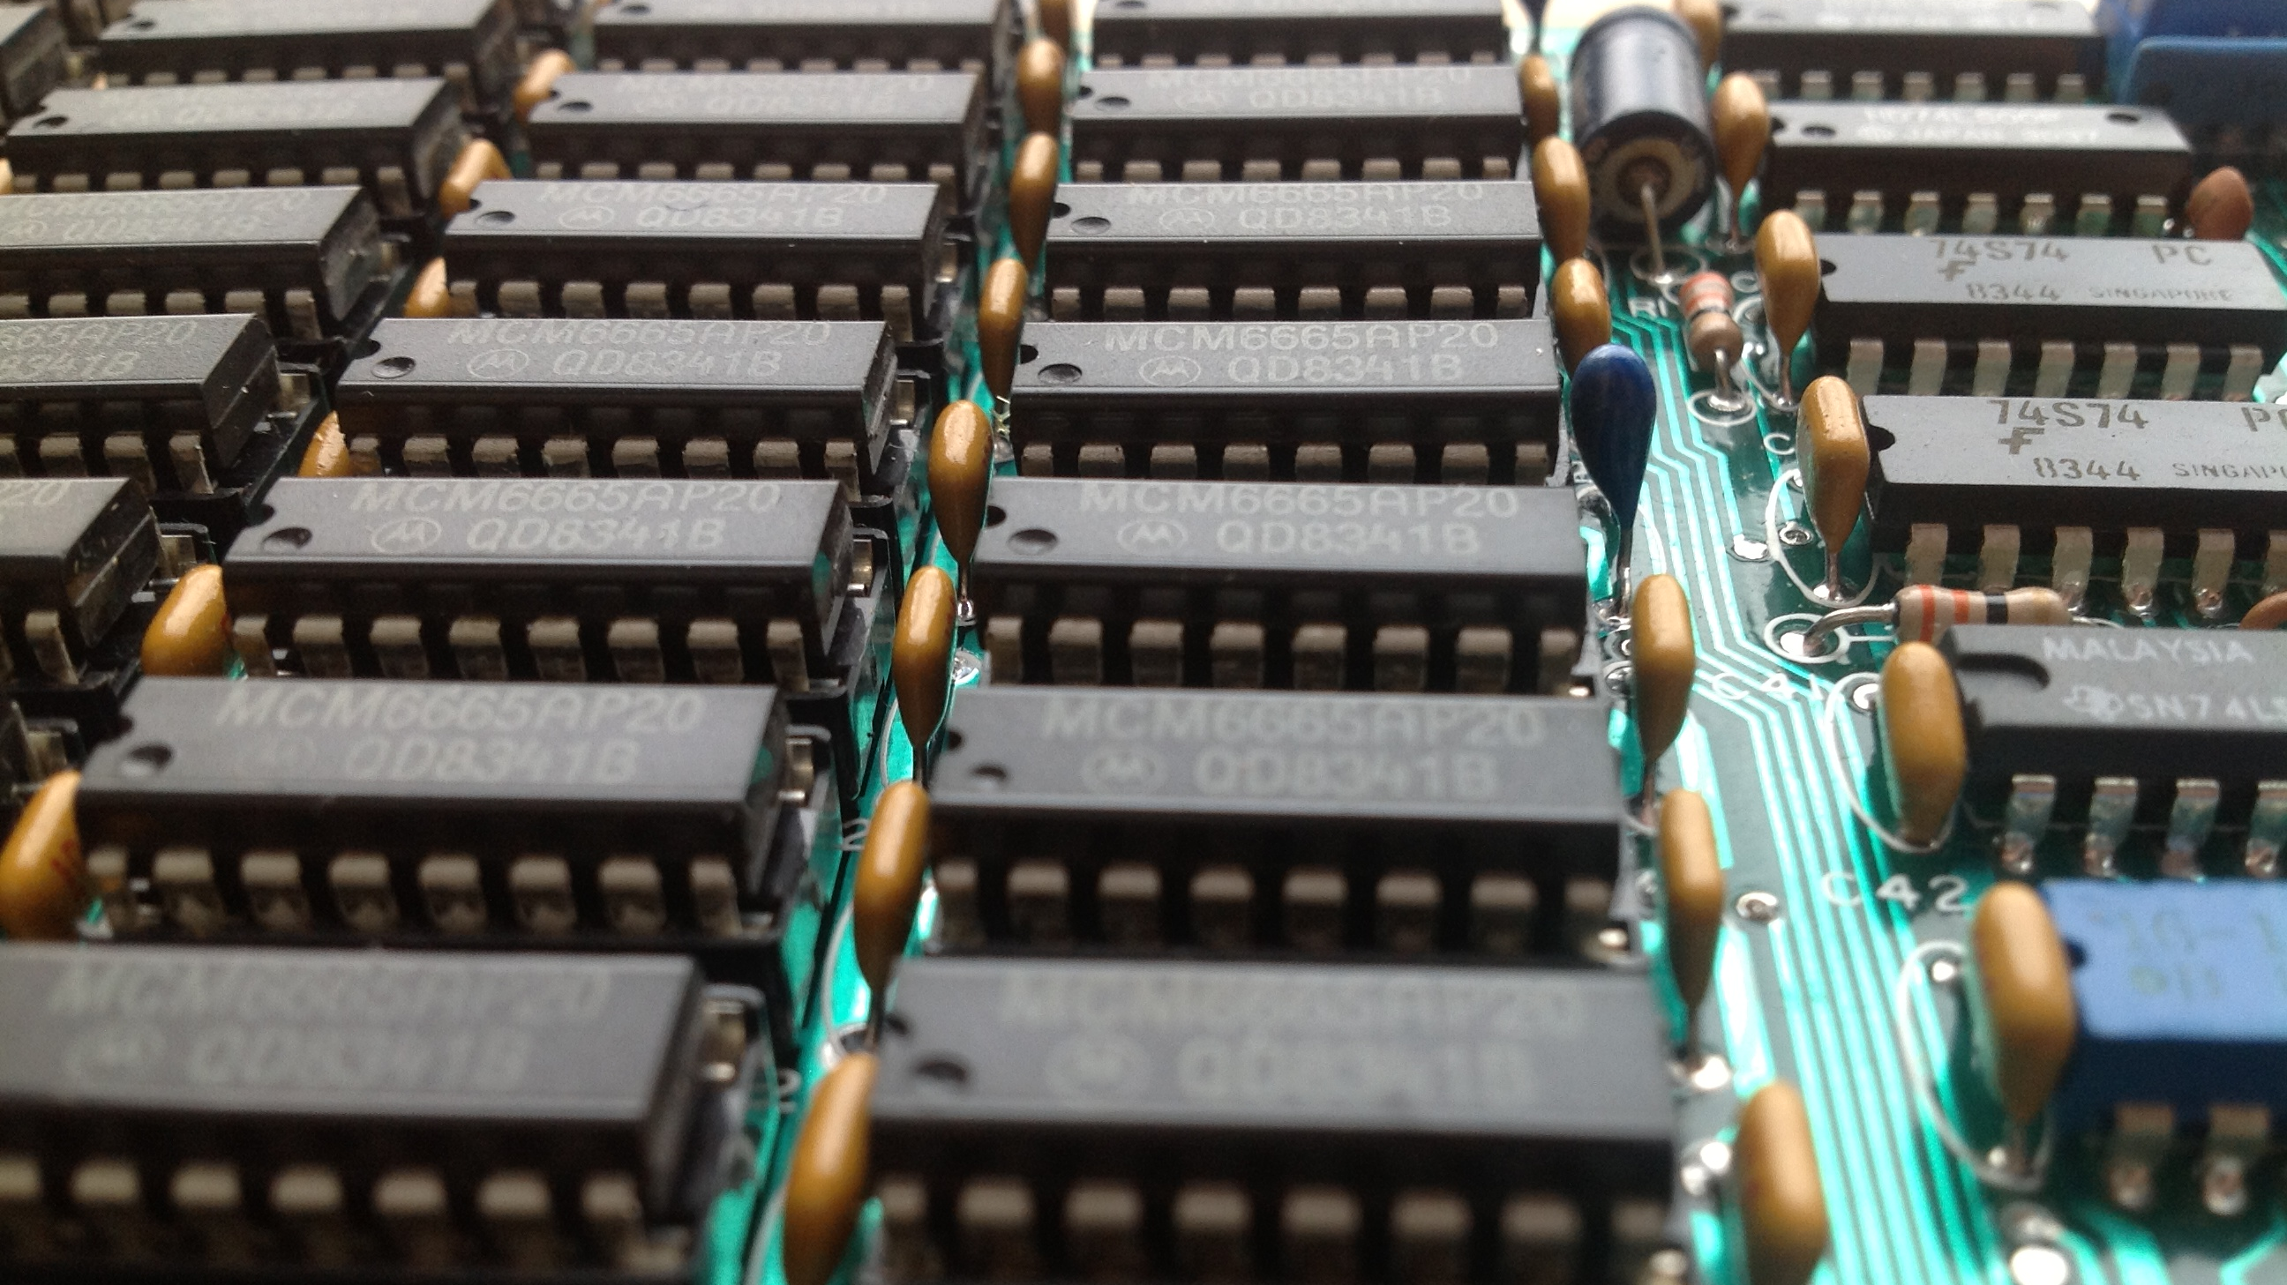
void GameLoop()
{
// swap the buffers over
doubleBufferFrameAlloc.SwapBuffers();
// clear the buffer
doubleBufferFrameAlloc.ClearCurrentBuffer();
// ...
// allocate out of the buffer for this frame
// this will still be valid *next* frame
void *p = doubleBufferFrameAlloc.Alloc(objectSize);
}
void GameLoop()
{
// clear the frame allocator prior
// to starting the frame
frameAlloc.Clear();
// do game stuff
// allocate from the frame buffer,
// we don't need to free this memory
// but we can only use it this frame.
void *pointer = frameAlloc.Alloc(objectSize);
}
Notes:
Most games have allocations that happen for the duration of a single frame (or maybe 2 at most), these short lived allocations can just as easily be handled with a stack allocator. We just “clear” it at the start of the frame, though there is a risk of programmers trying to access something in the next frame, after it has been cleared (note that there is also a chance for something to still be present in memory, we don’t actually change the memory space when we clear it). For allocations we want to last into the next frame, we can implement a double buffered allocator, which has two stacks of memory that are swapped between – so at the start of a frame, we swap the buffers and clear the current buffer, leaving the last frames buffer free to be accessed in the current frame. These sorts of double buffered allocators are ideal for handling asynchronous processing results, we start something in frame i, at the start of frame i+1 we swap the buffers and we can still access the location of the result of the process.

Slide 10
free
Notes:
One final thing to consider is memory fragmentation, which occurs because when a program first runs, the heap is completely empty – but as allocations and deallocations are made, blocks of different sizes appear in the heap, so while we have enough free memory to allocate something, we can’t find that space in one contiguous space, as is required to be able to use the space. This means allocations can fail, even though we have enough free memory available as a whole. This is a fairly undesirable state of affairs. Thankfully, operating systems with virtual memory systems alleviate this for us (so, we have to be less concerned about this for a PC / Mac based game) though there is an inherent performance cost associated with working inside a virtual memory system so even on consoles that support it, most game engines will avoid making use of them.
Using stack or pool allocators means we can avoid the issue completely, but for other types of allocators, we may need to consider a system that would allow us to defragment our memory usage to free up small chunks of ‘free’ memory that is otherwise unusable. However, as soon as we step into that murky water, we open a whole new barrel of worms as we’re suddenly moving *allocated* memory around the place and that can be seriously bad juju as it screws up any pointers we have pointing to that memory. Gregory goes into more details with regards to approaching this, but we’ll skip it for the sake of our own sanity.

